Slide 1

Real-World Perspectives on Personalizing Therapy in Knee Osteoarthritis

Slide 2
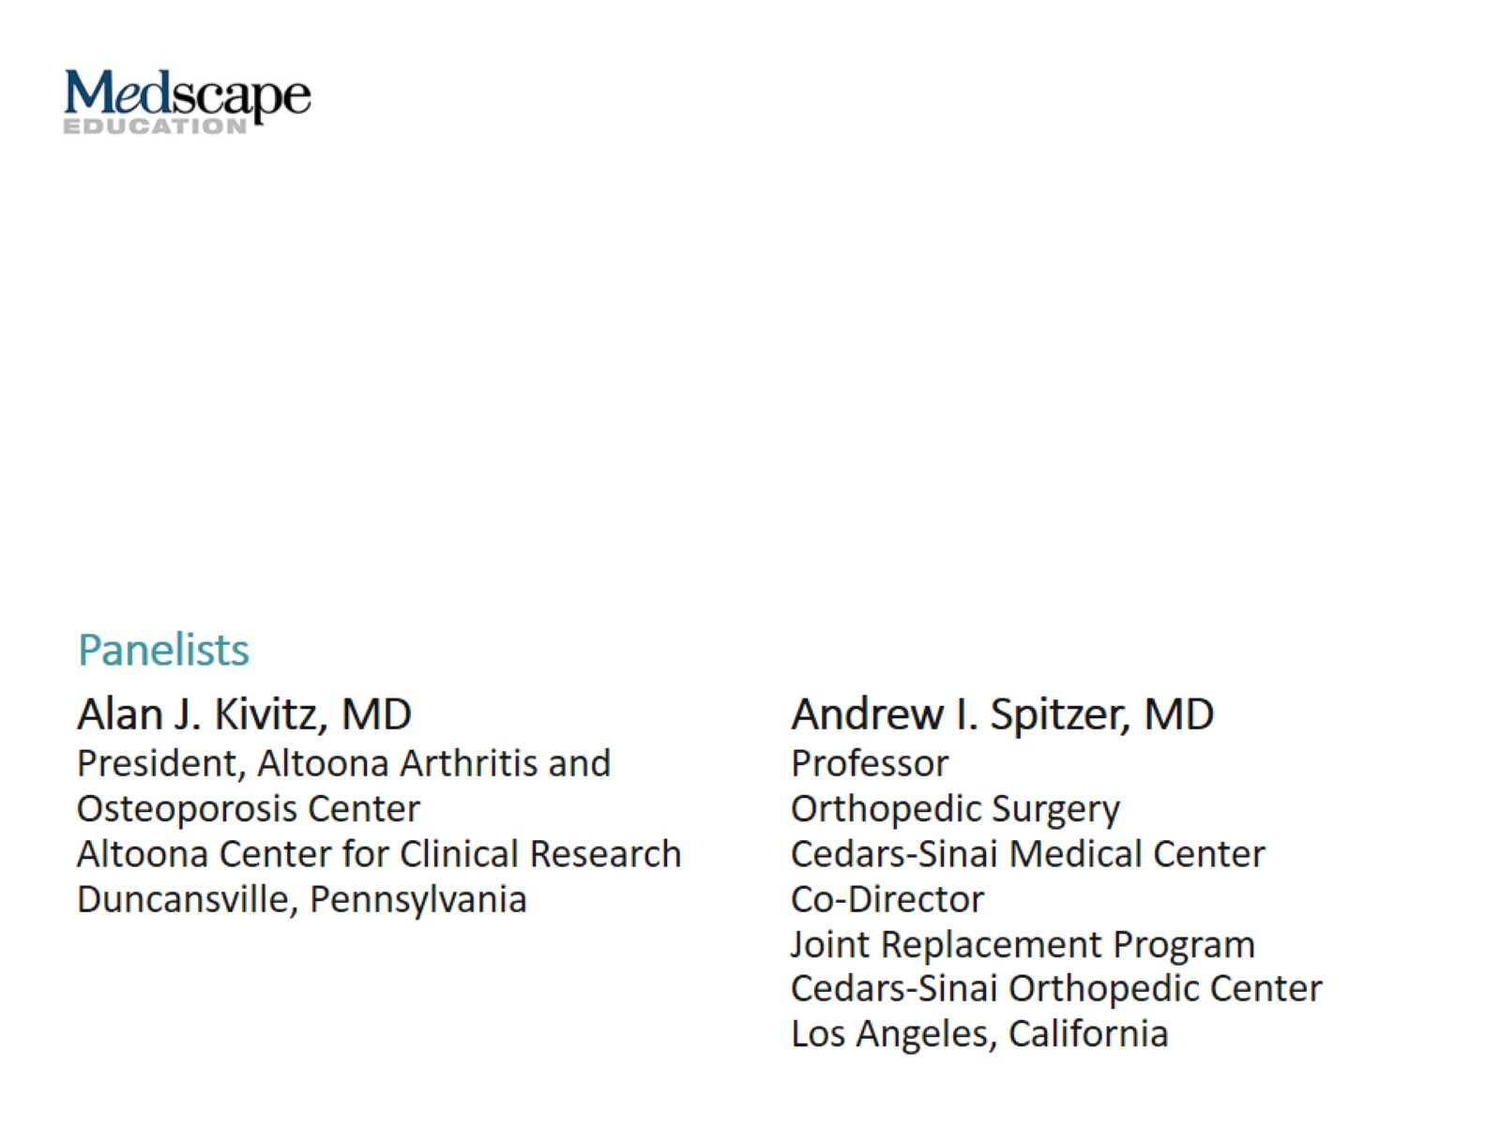

Slide 3
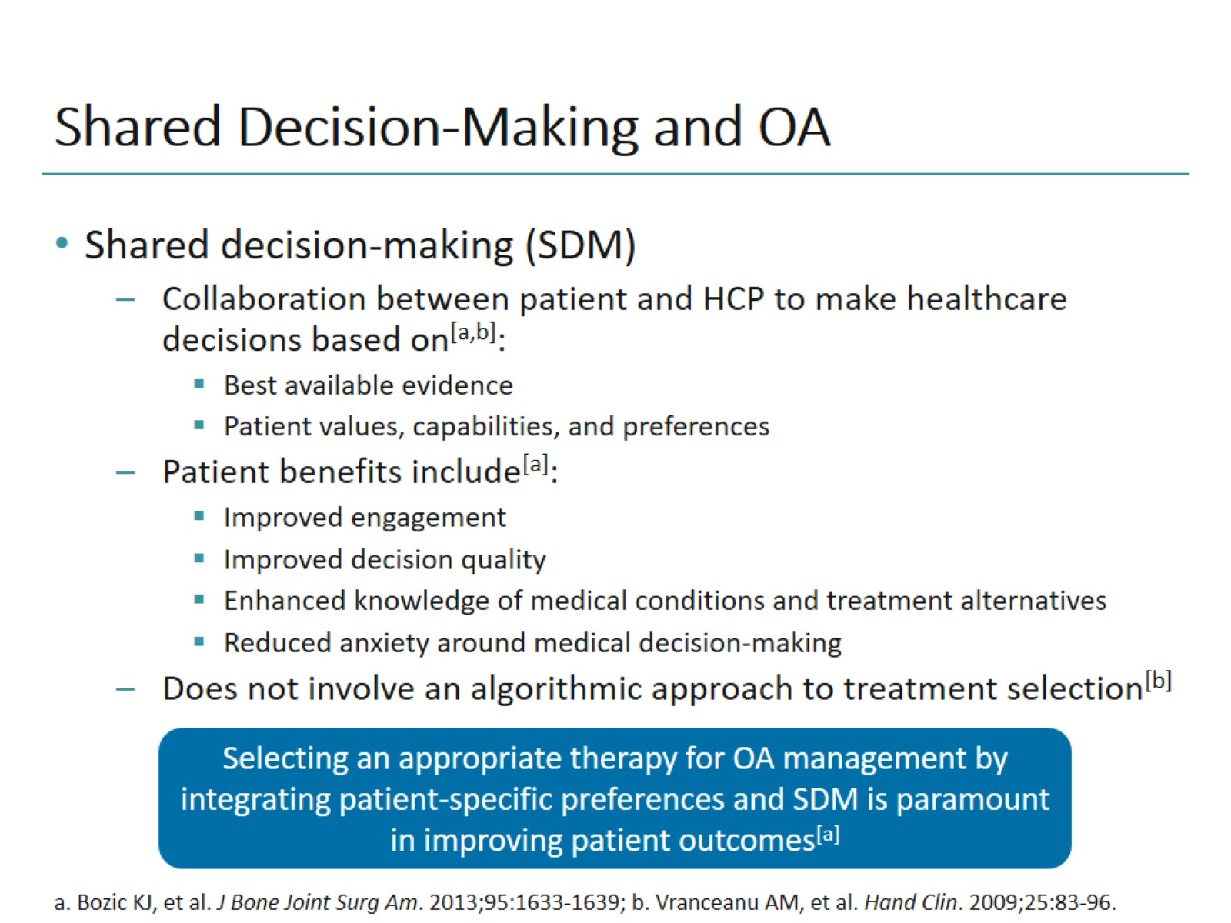
Shared Decision-Making and OA

Slide 4
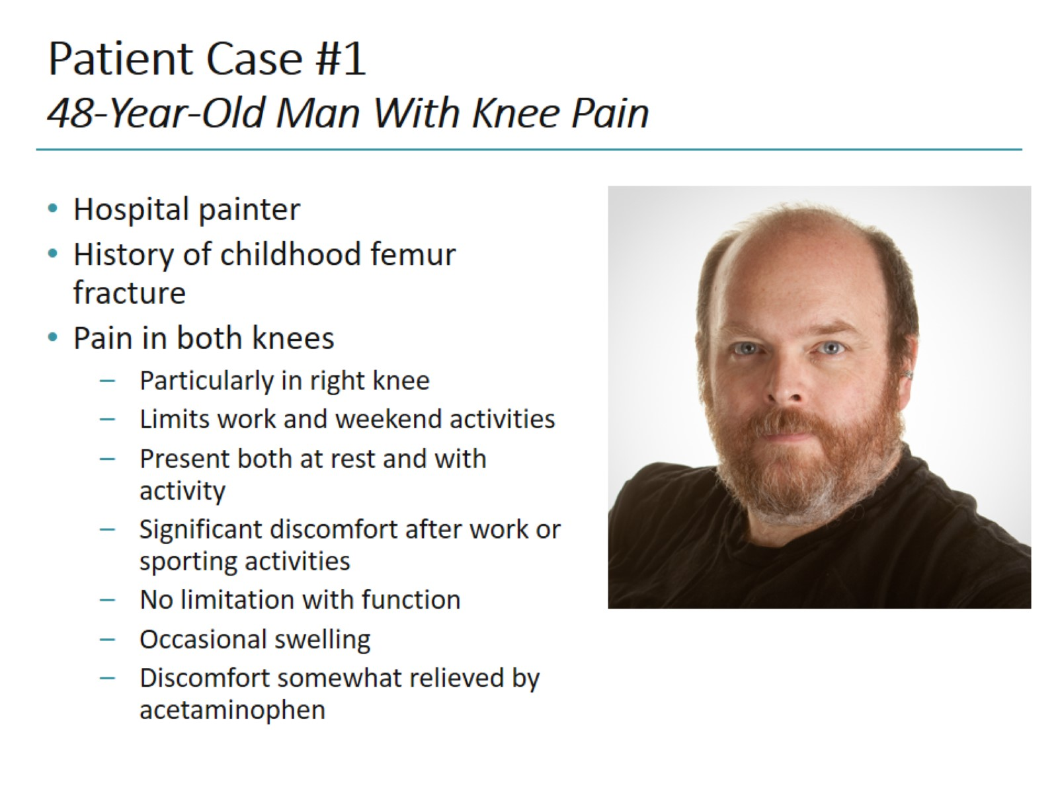
Patient Case #1 48-Year-Old Man With Knee Pain

Slide 5
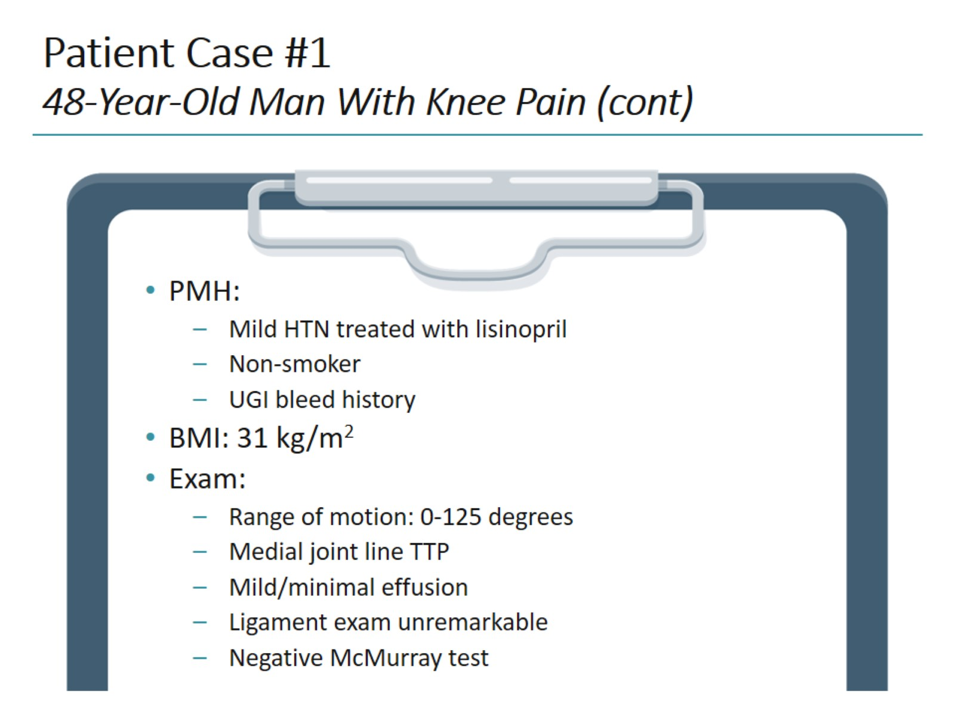
Patient Case #1 48-Year-Old Man With Knee Pain (cont)

Slide 6
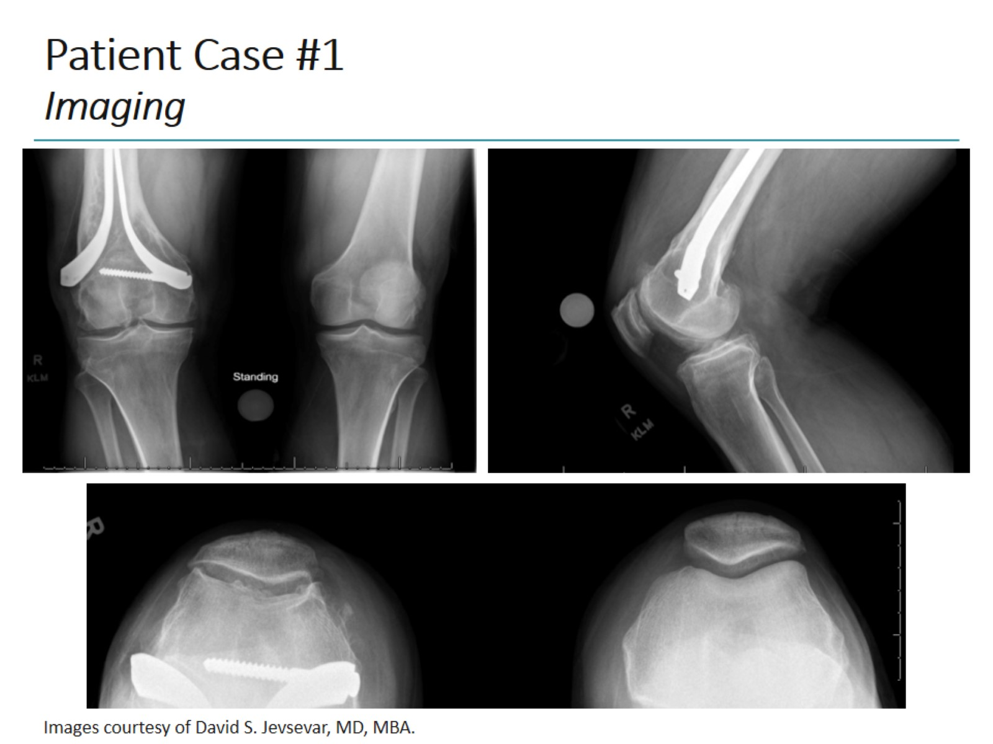
Patient Case #1 Imaging

Slide 7
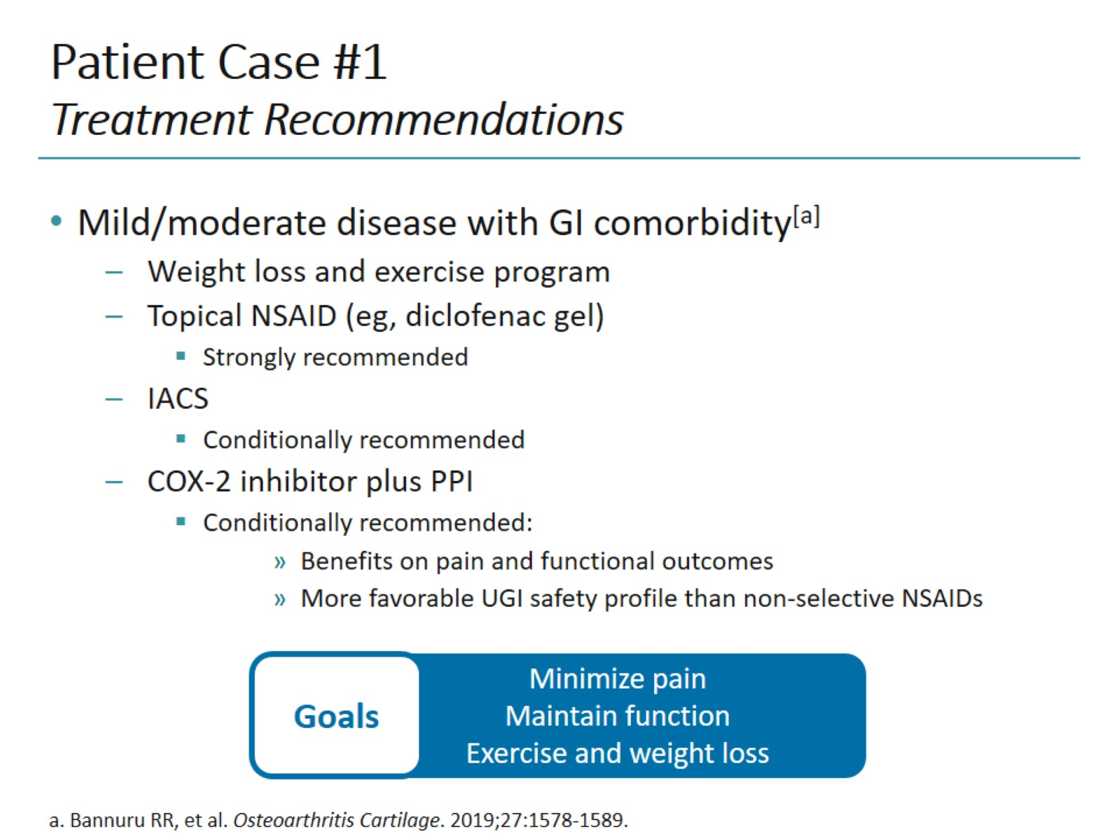
Patient Case #1 Treatment Recommendations

Slide 8
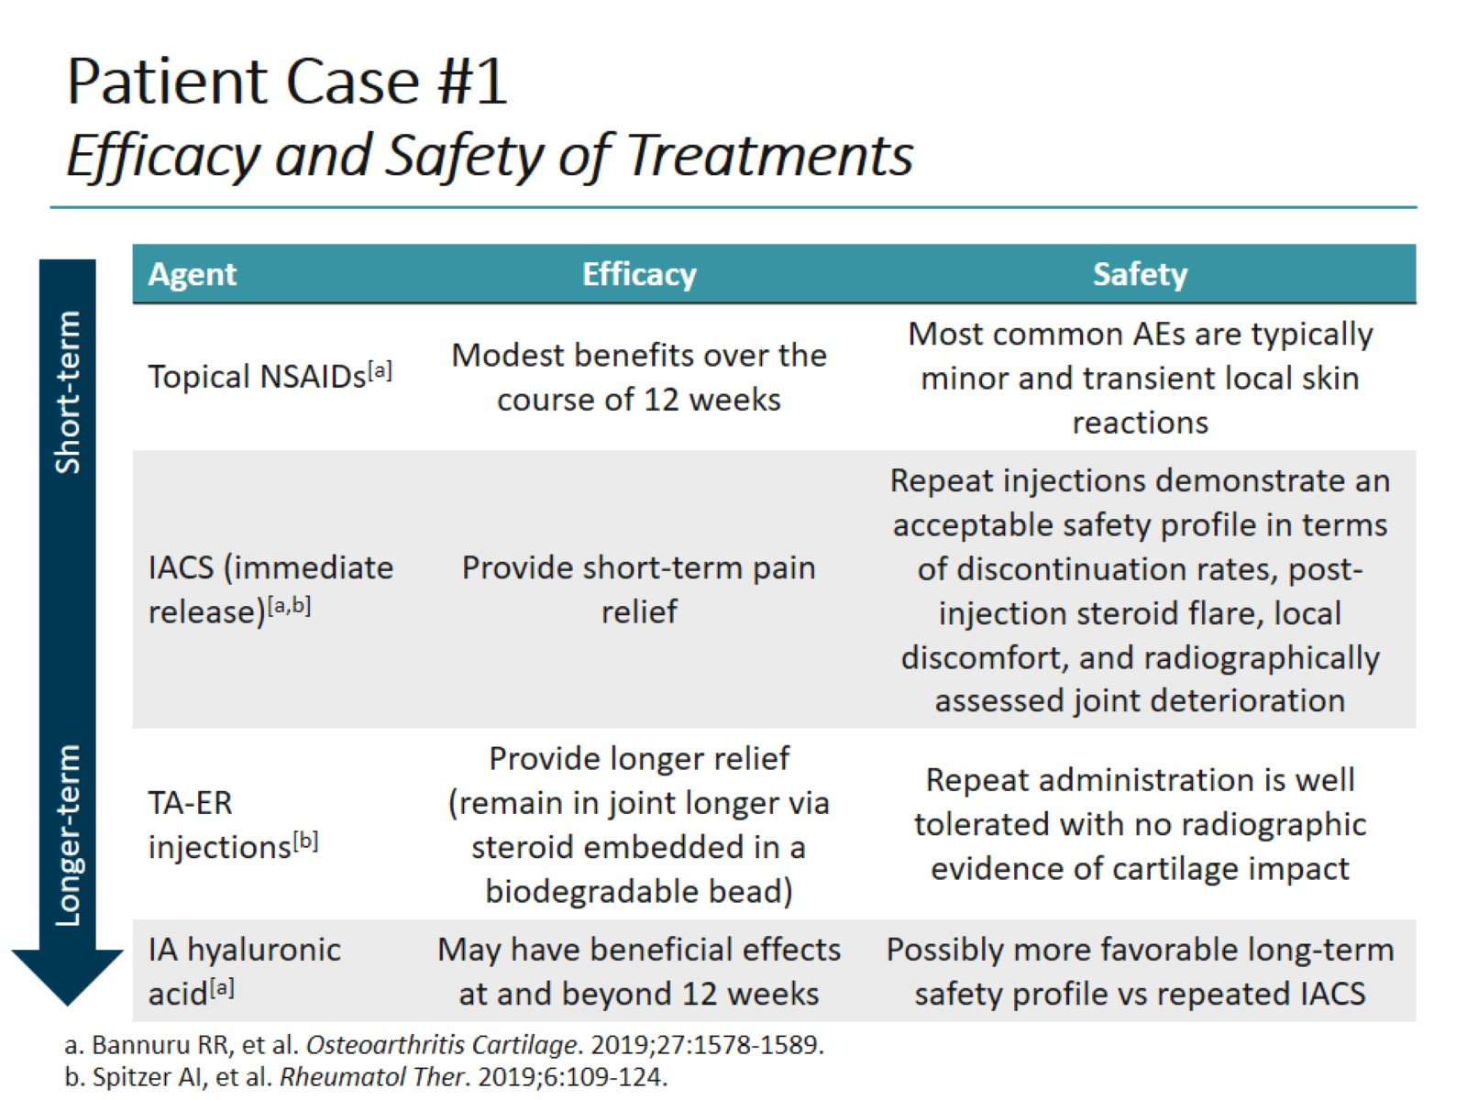
Patient Case #1 Efficacy and Safety of Treatments

Slide 9
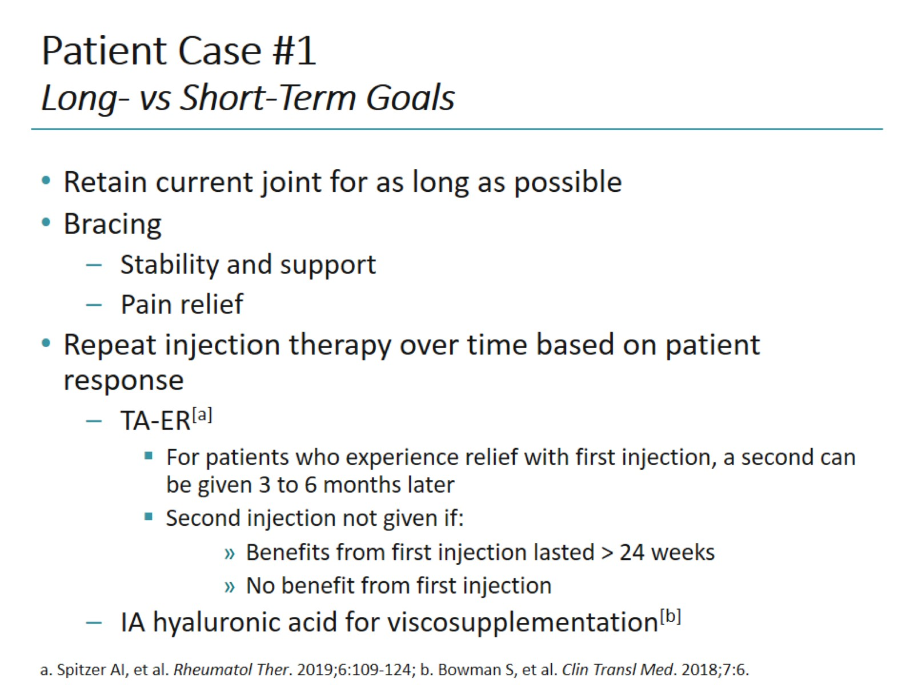
Patient Case #1 Long- vs Short-Term Goals

Slide 10
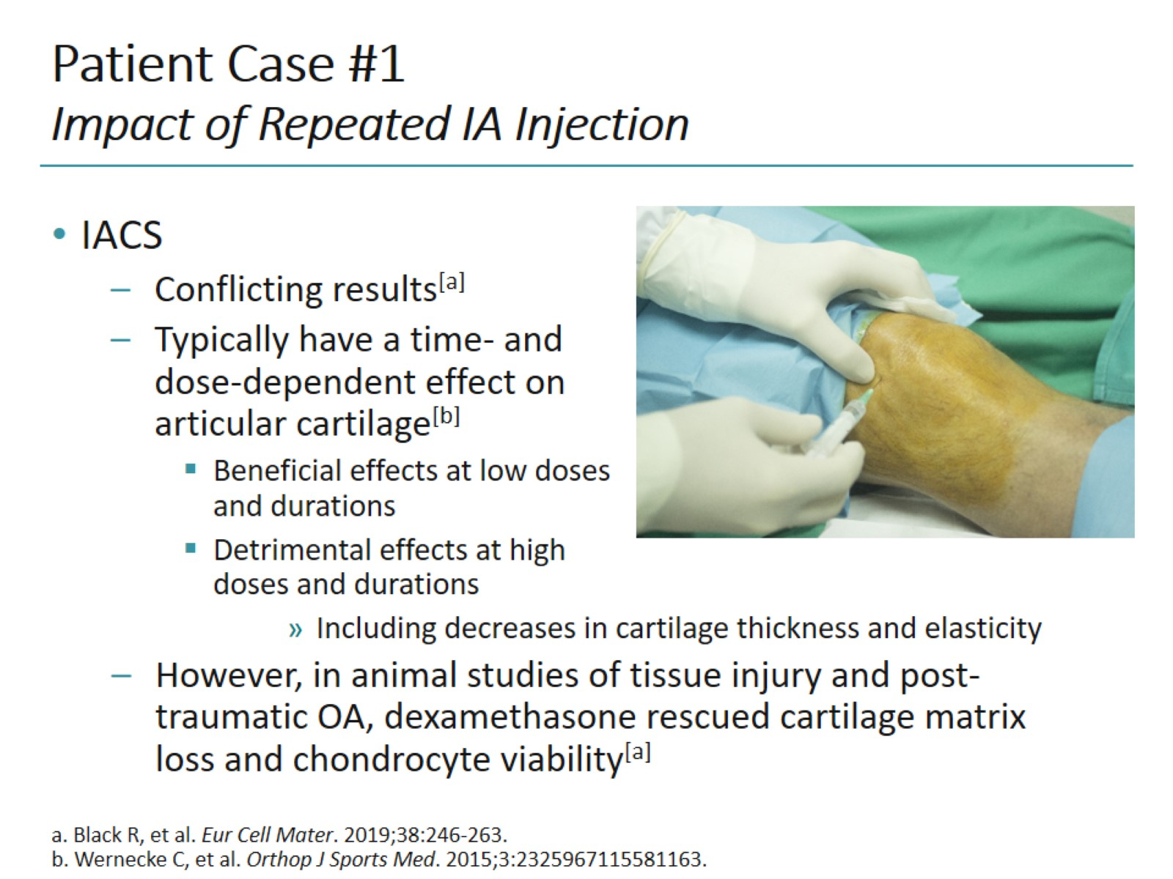
Patient Case #1 Impact of Repeated IA Injection

Slide 11
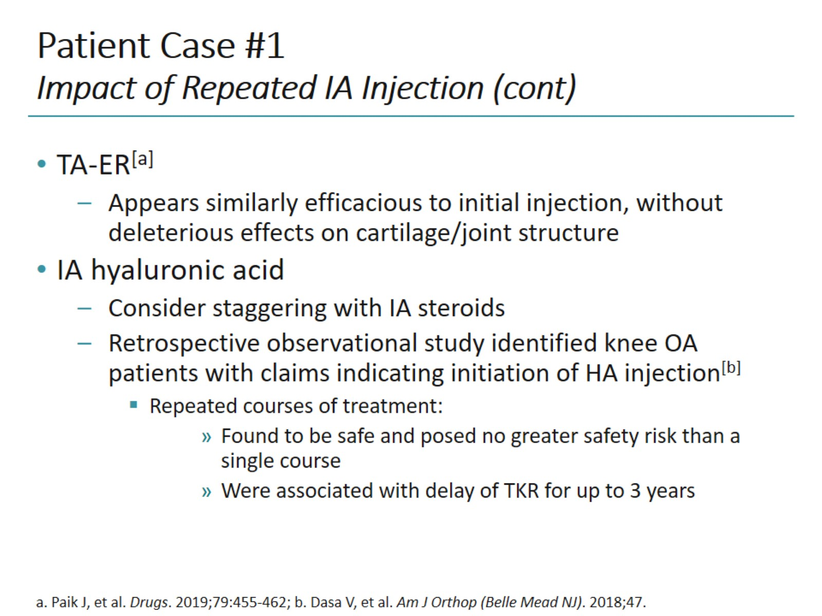
Patient Case #1 Impact of Repeated IA Injection (cont)

Slide 12
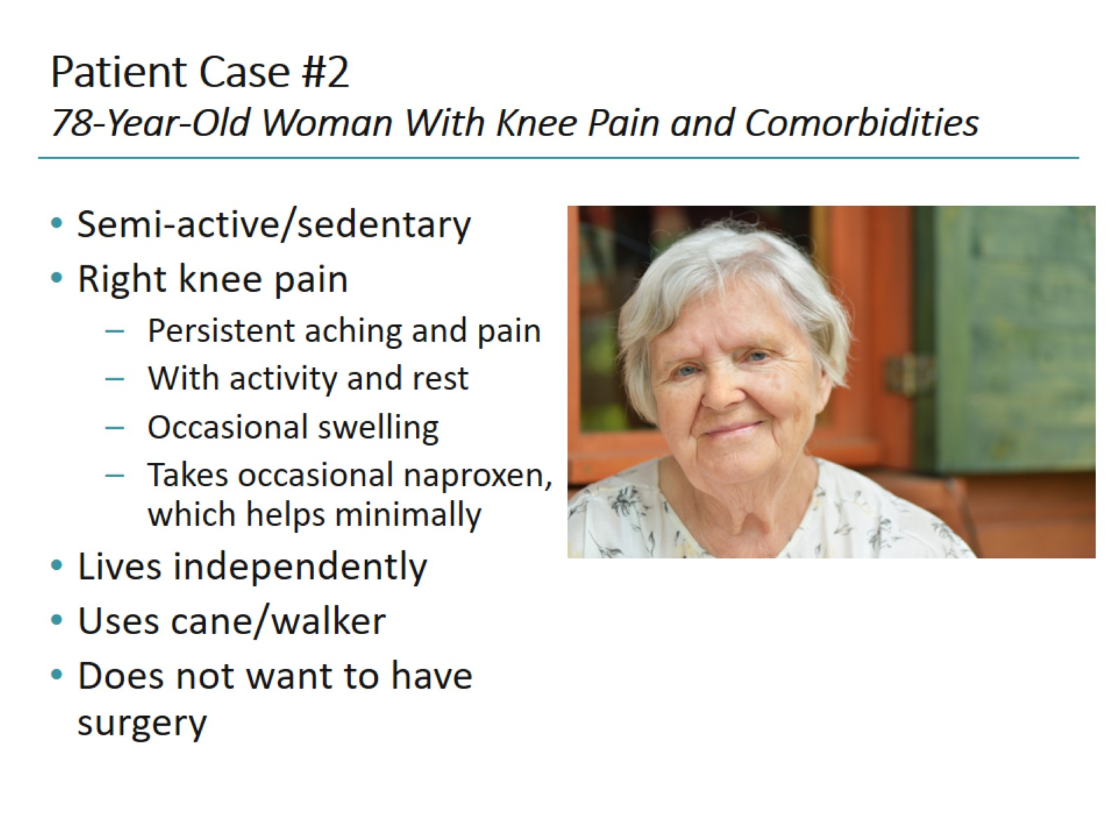
Patient Case #2 78-Year-Old Woman With Knee Pain and Comorbidities

Slide 13
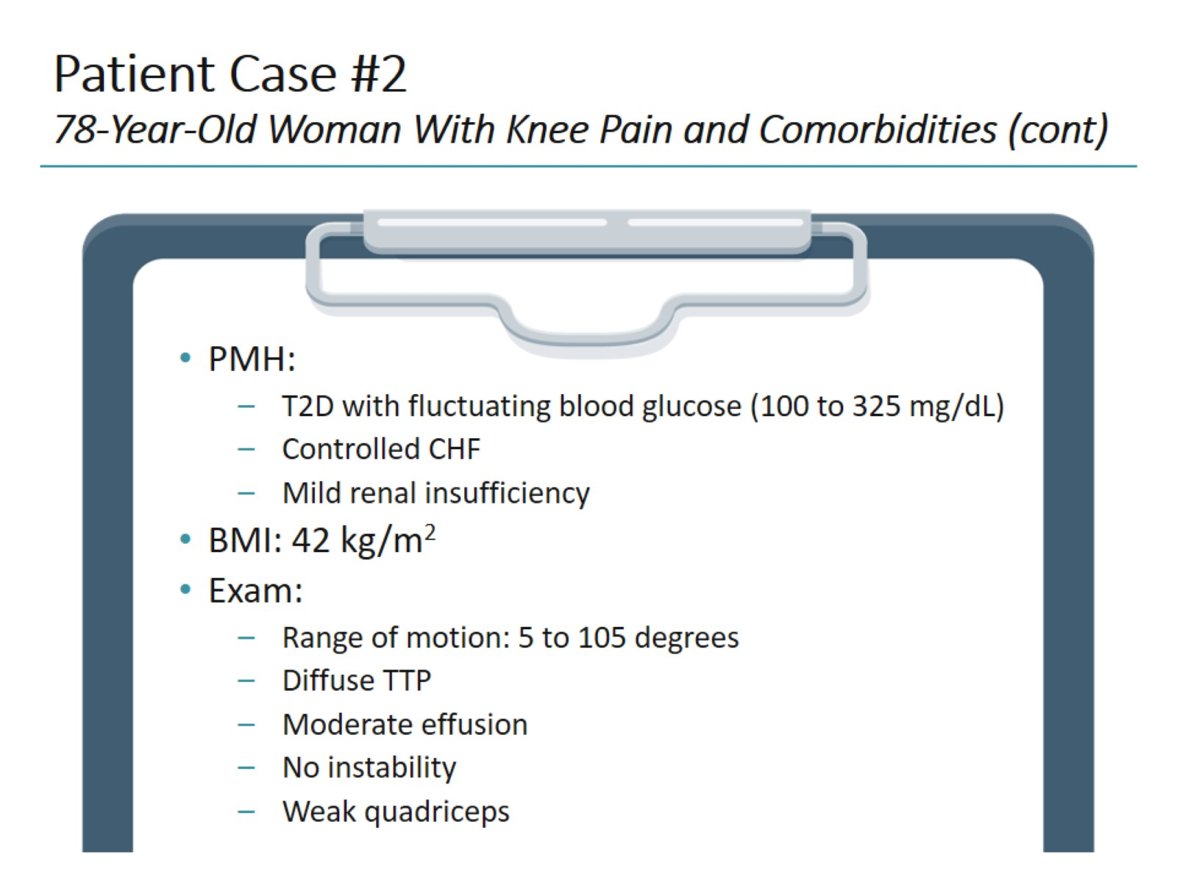
Patient Case #2 78-Year-Old Woman With Knee Pain and Comorbidities (cont)

Slide 14
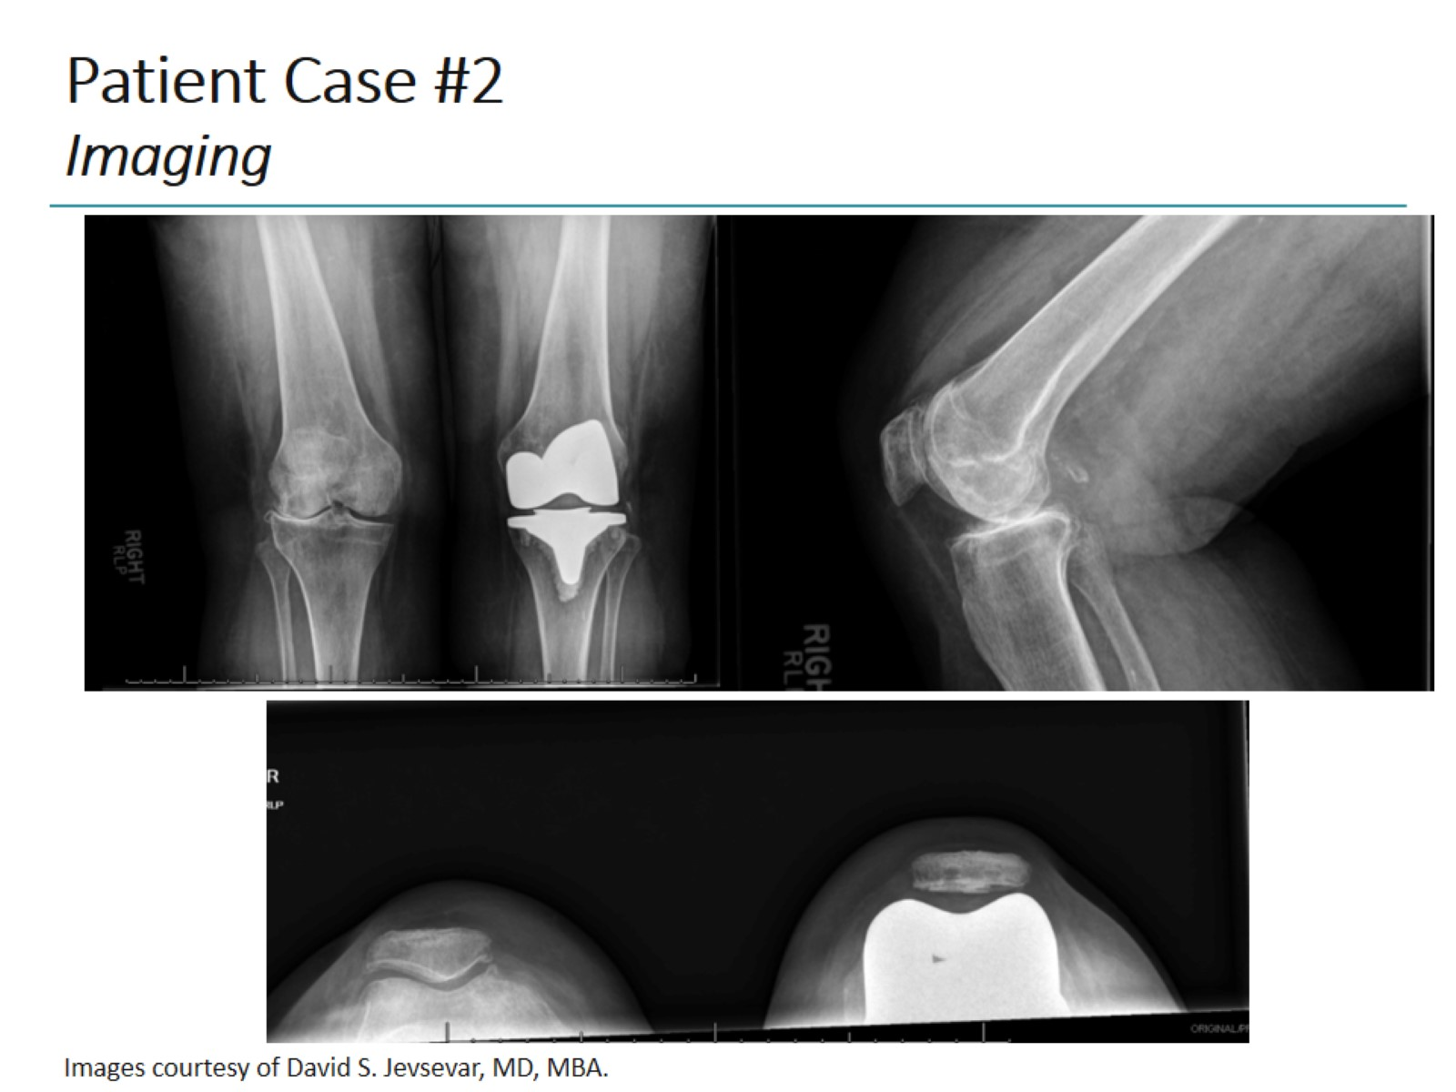
Patient Case #2 Imaging

Slide 15
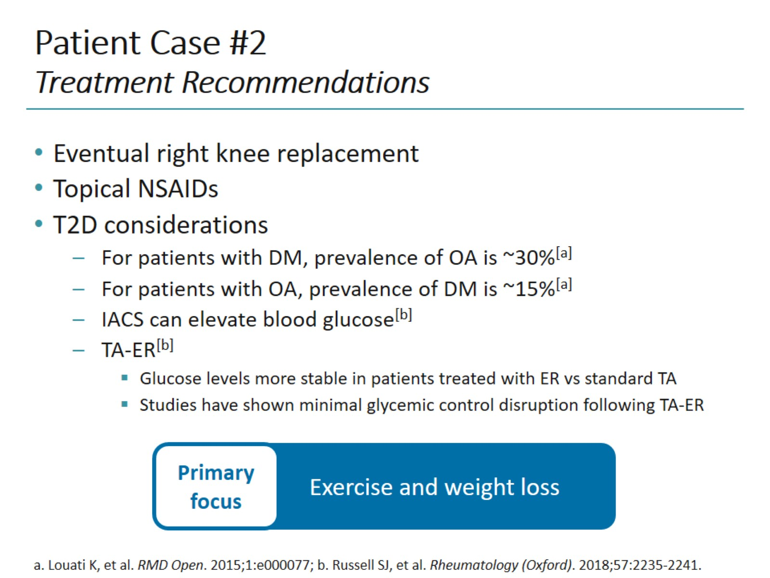
Patient Case #2 Treatment Recommendations

Slide 16
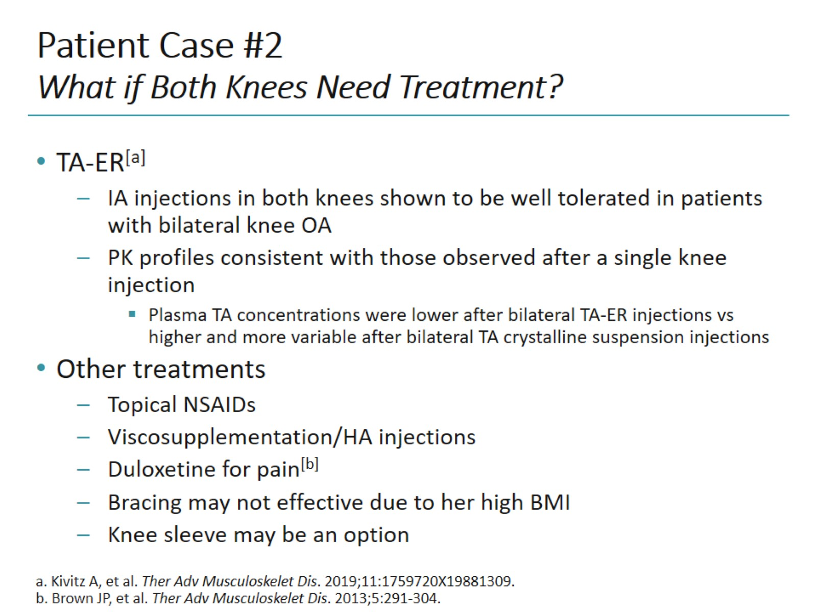
Patient Case #2 What if Both Knees Need Treatment?

Slide 17
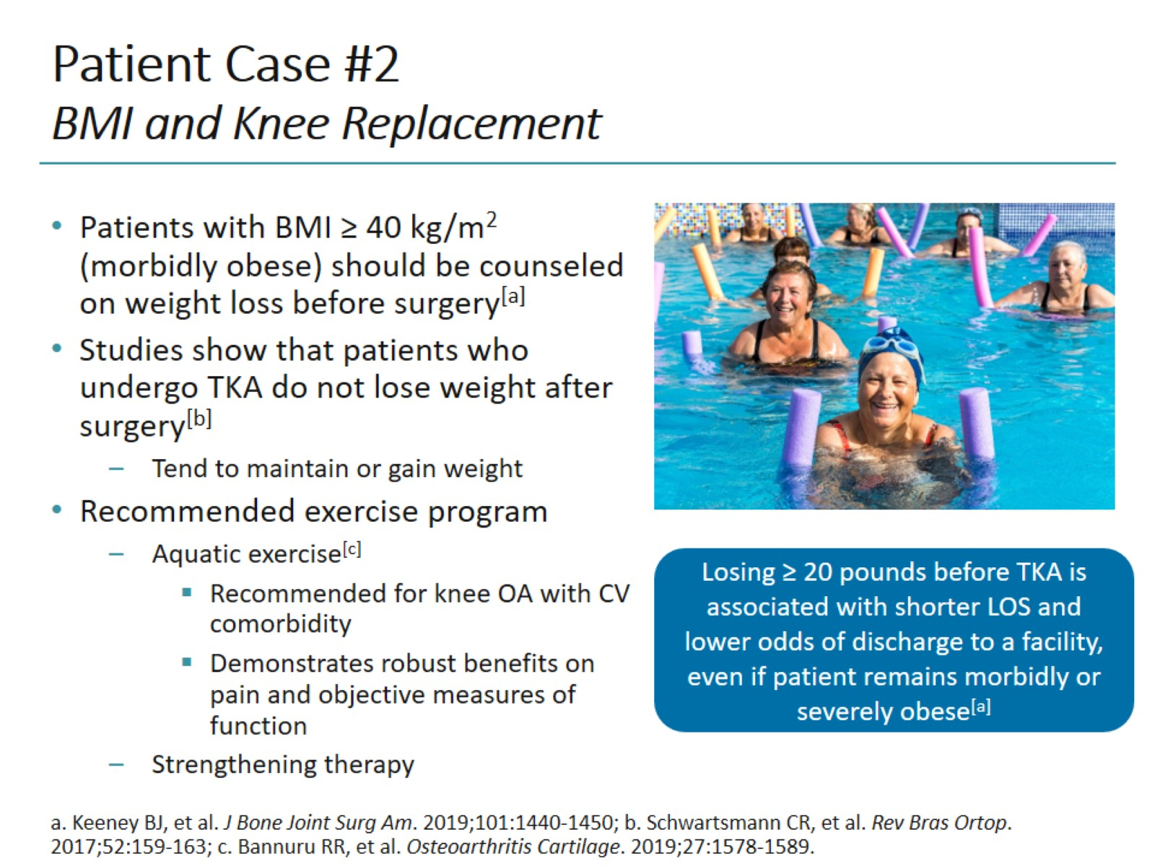
Patient Case #2 BMI and Knee Replacement

Slide 18
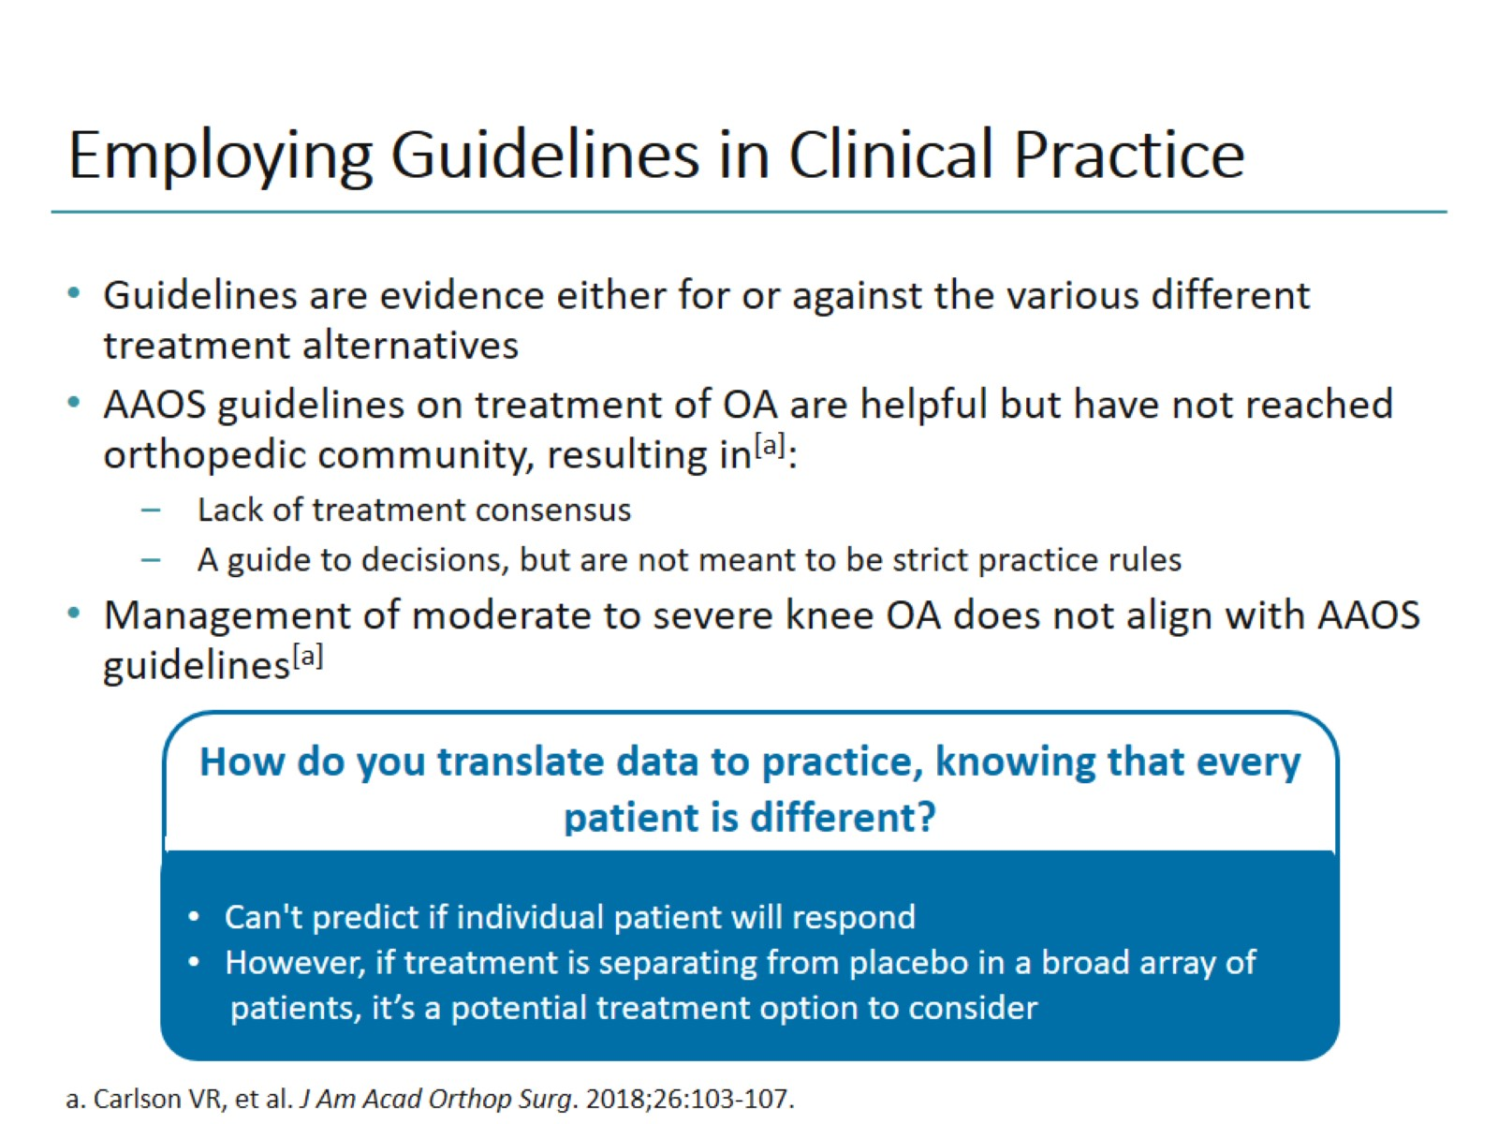
Employing Guidelines in Clinical Practice

Slide 19
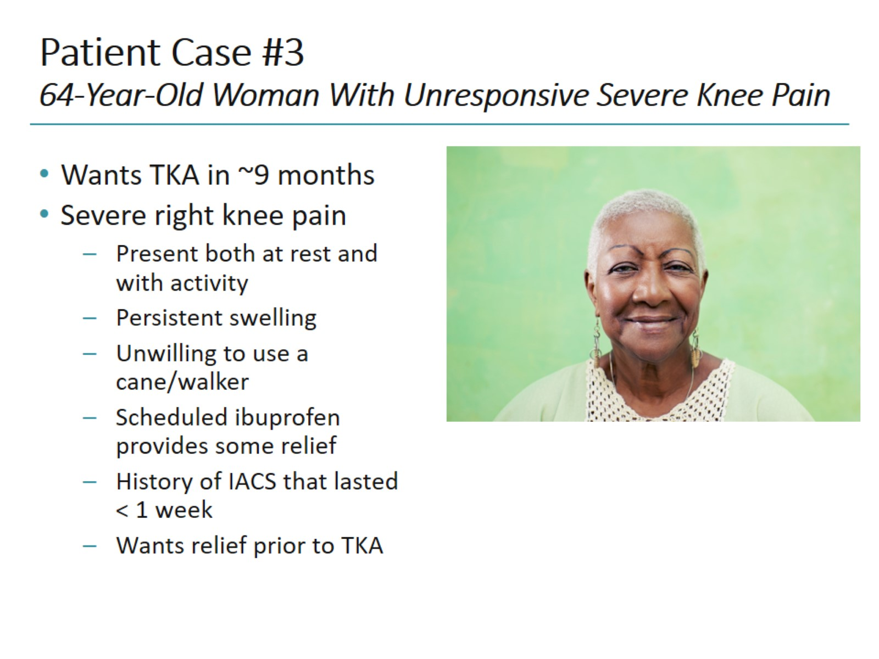
Patient Case #3 64-Year-Old Woman With Unresponsive Severe Knee Pain

Slide 20
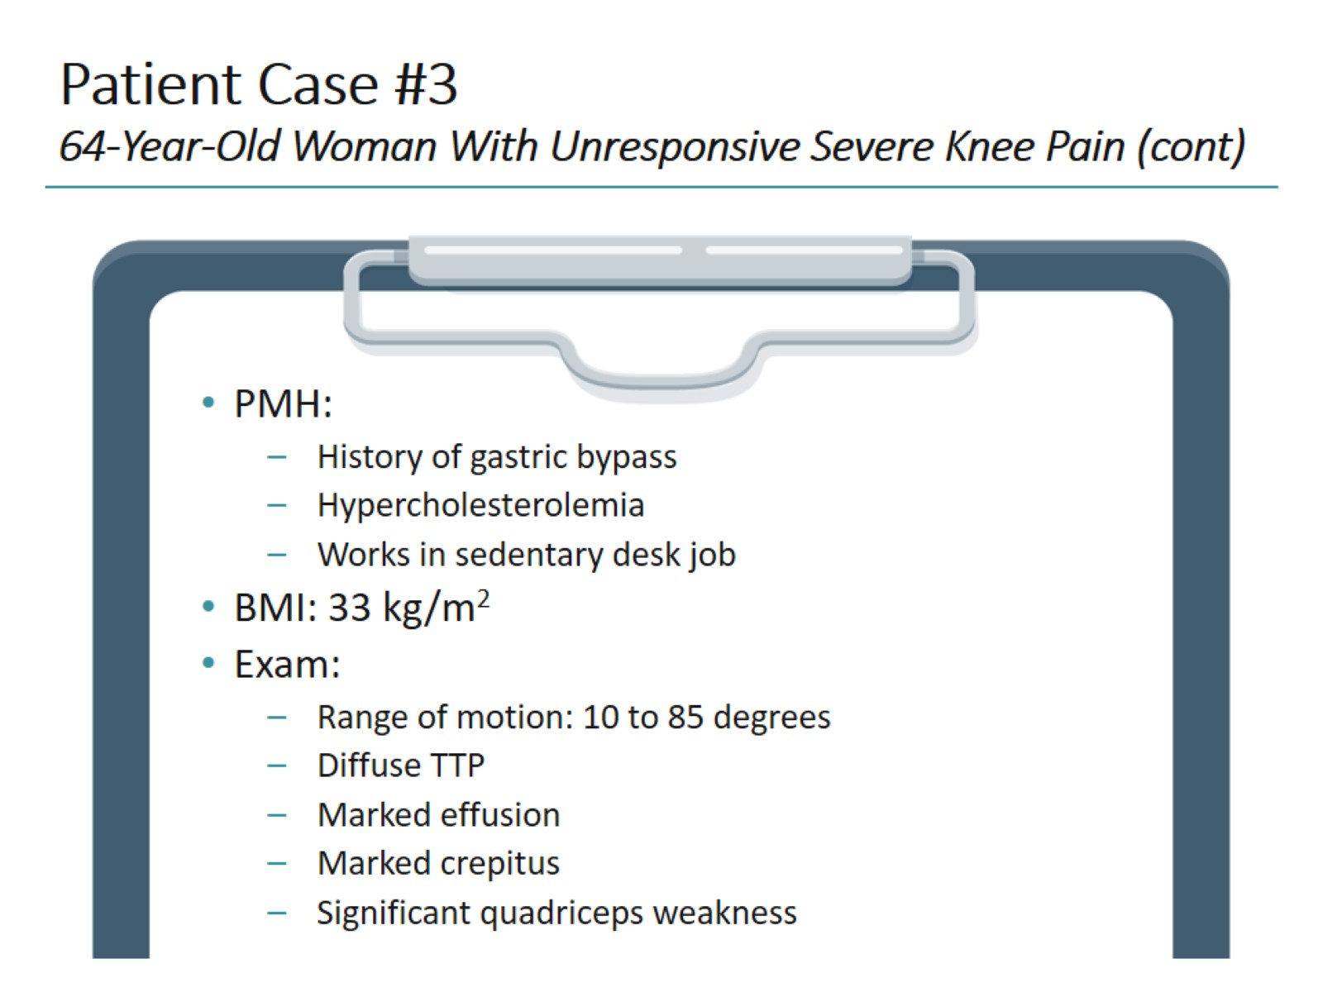
Patient Case #3 64-Year-Old Woman With Unresponsive Severe Knee Pain (cont)

Slide 21
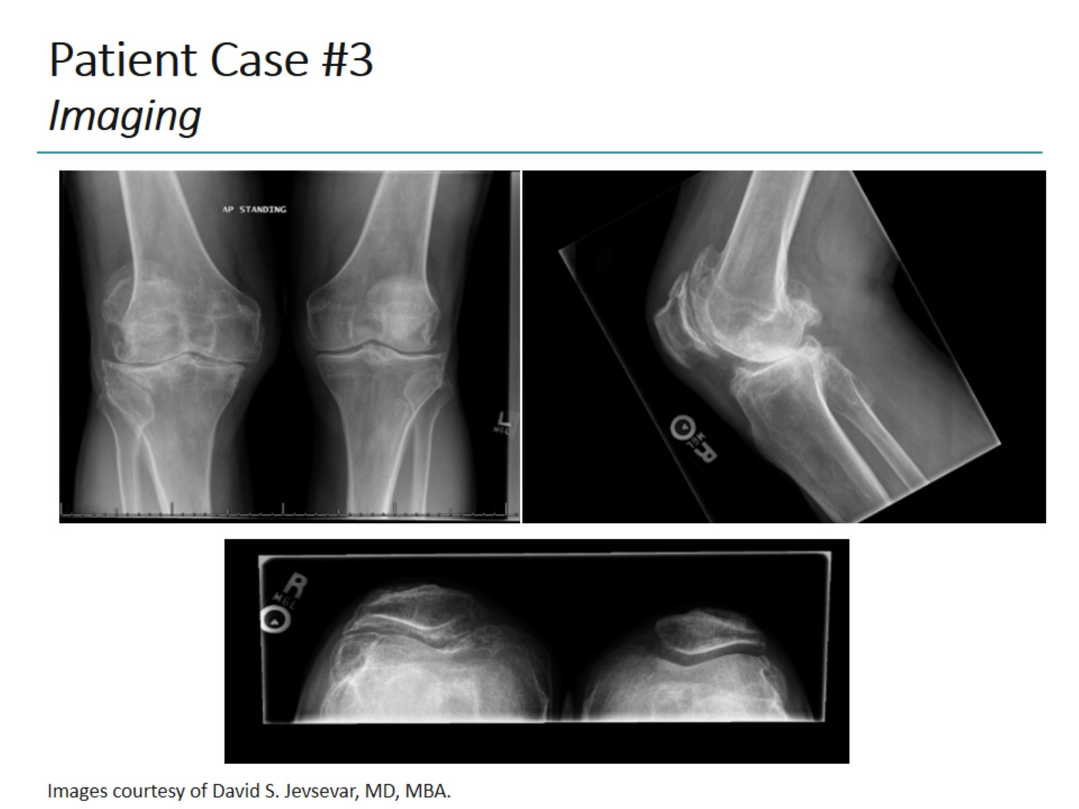
Patient Case #3 Imaging

Slide 22
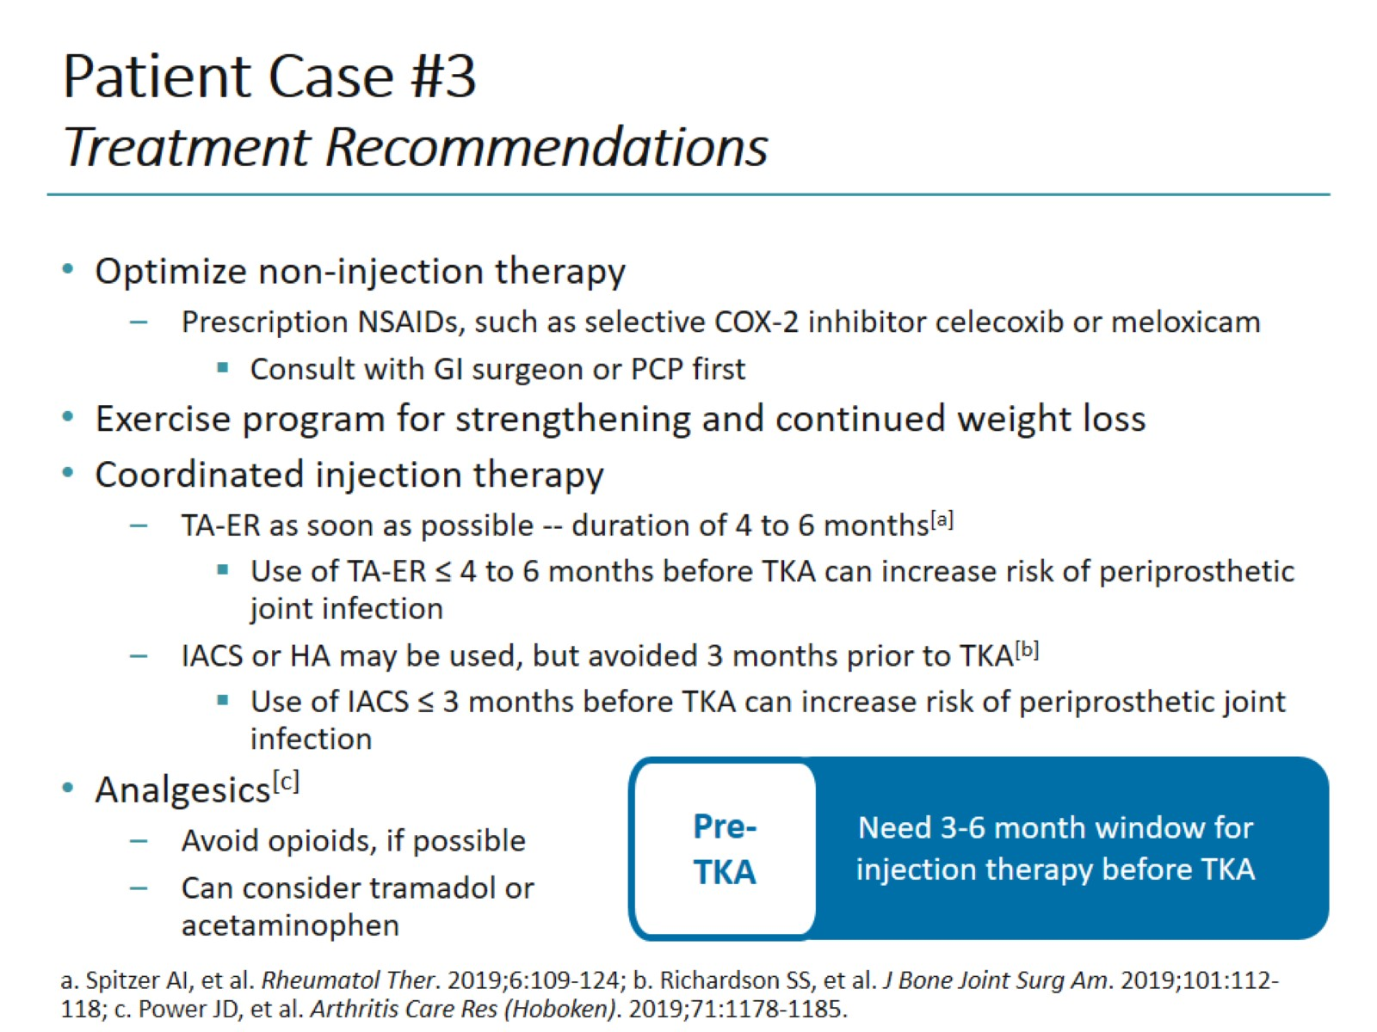
Patient Case #3 Treatment Recommendations

Slide 23
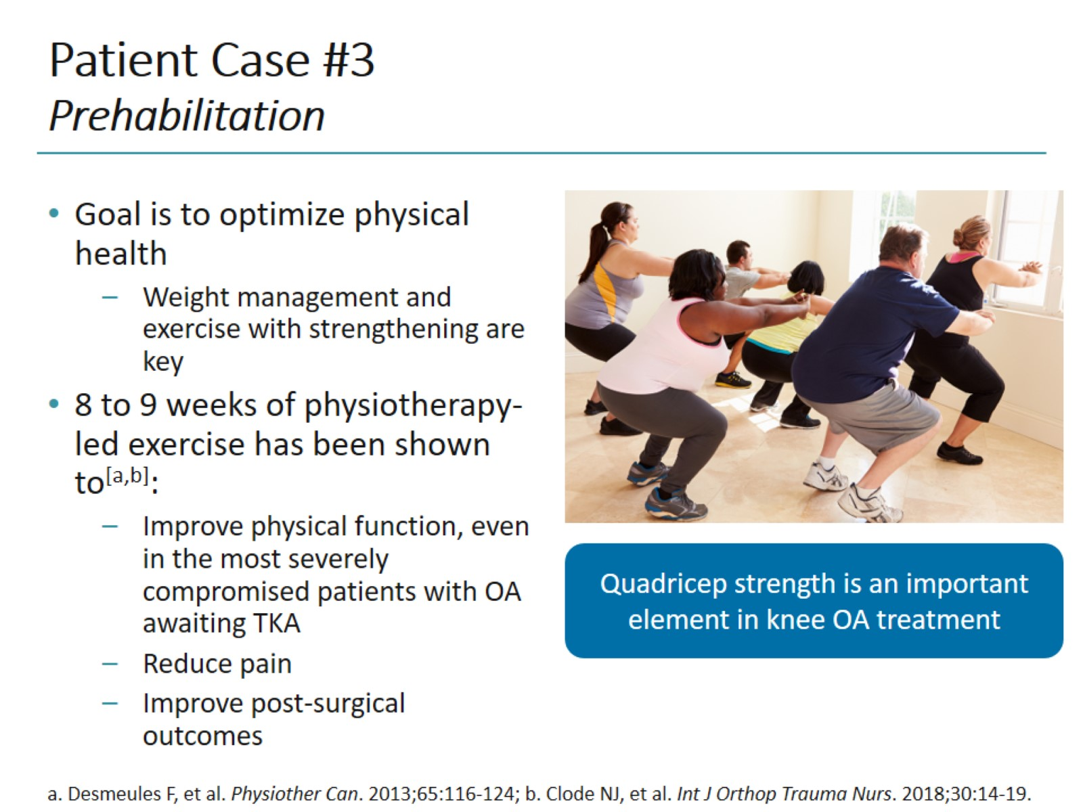
Patient Case #3 Prehabilitation

Slide 24
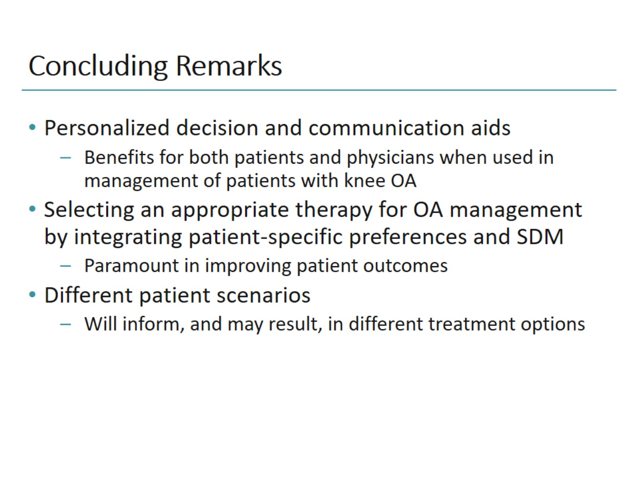
Concluding Remarks

Slide 25
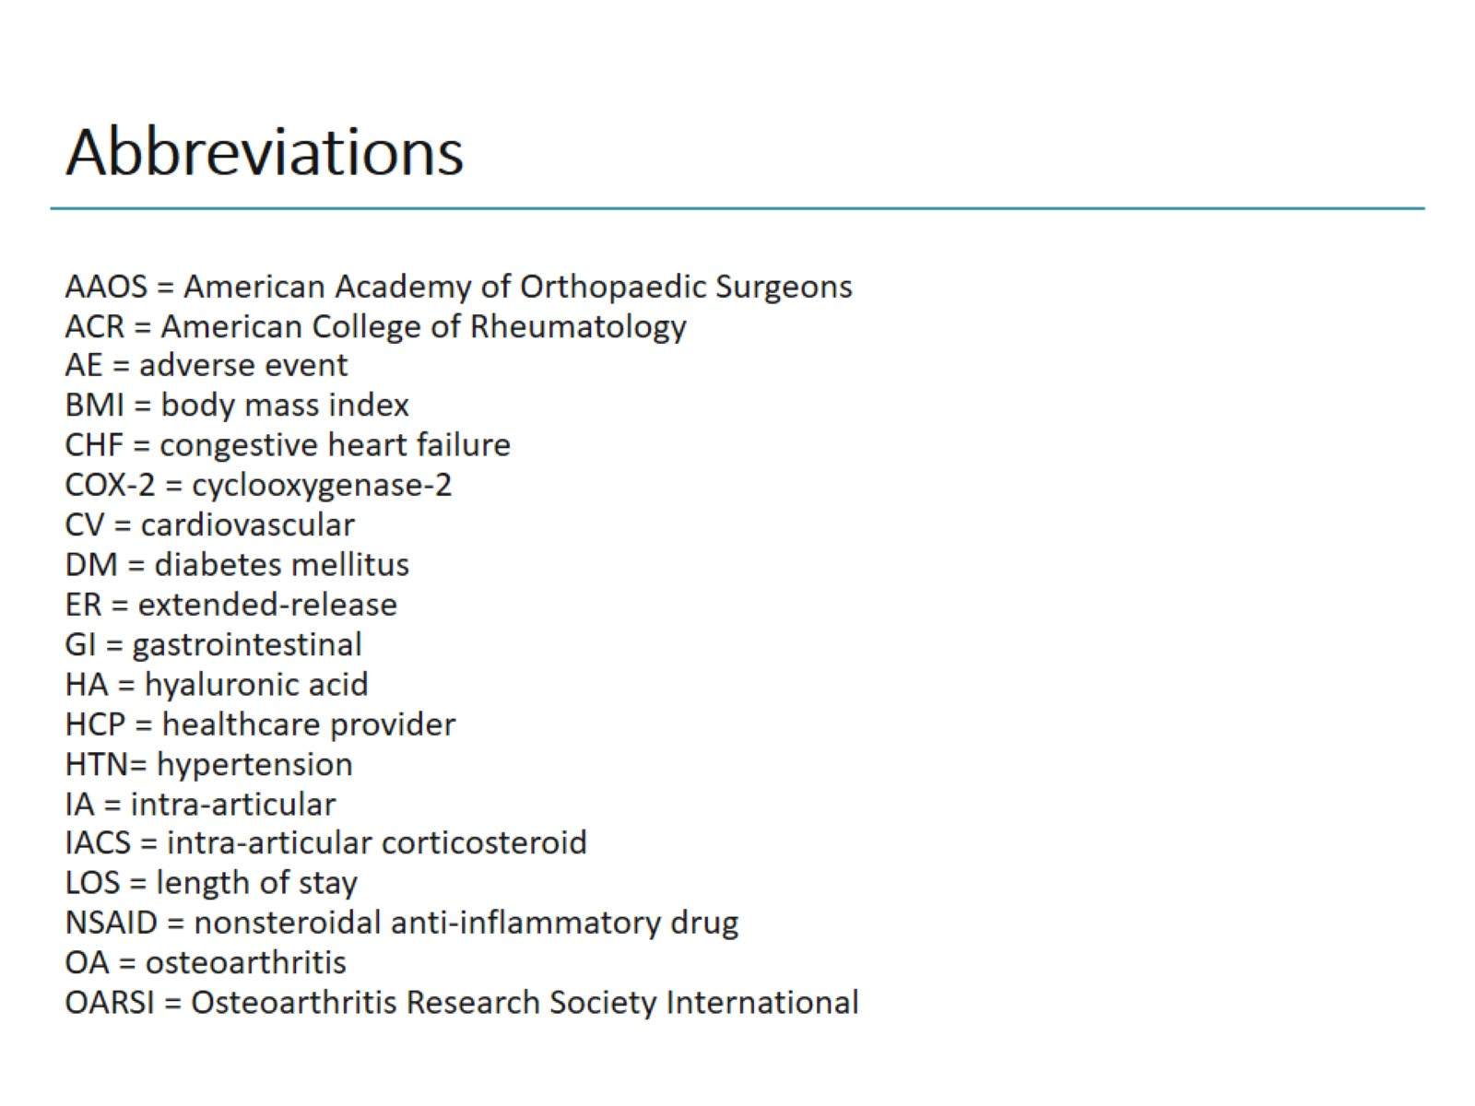
Abbreviations

Slide 26
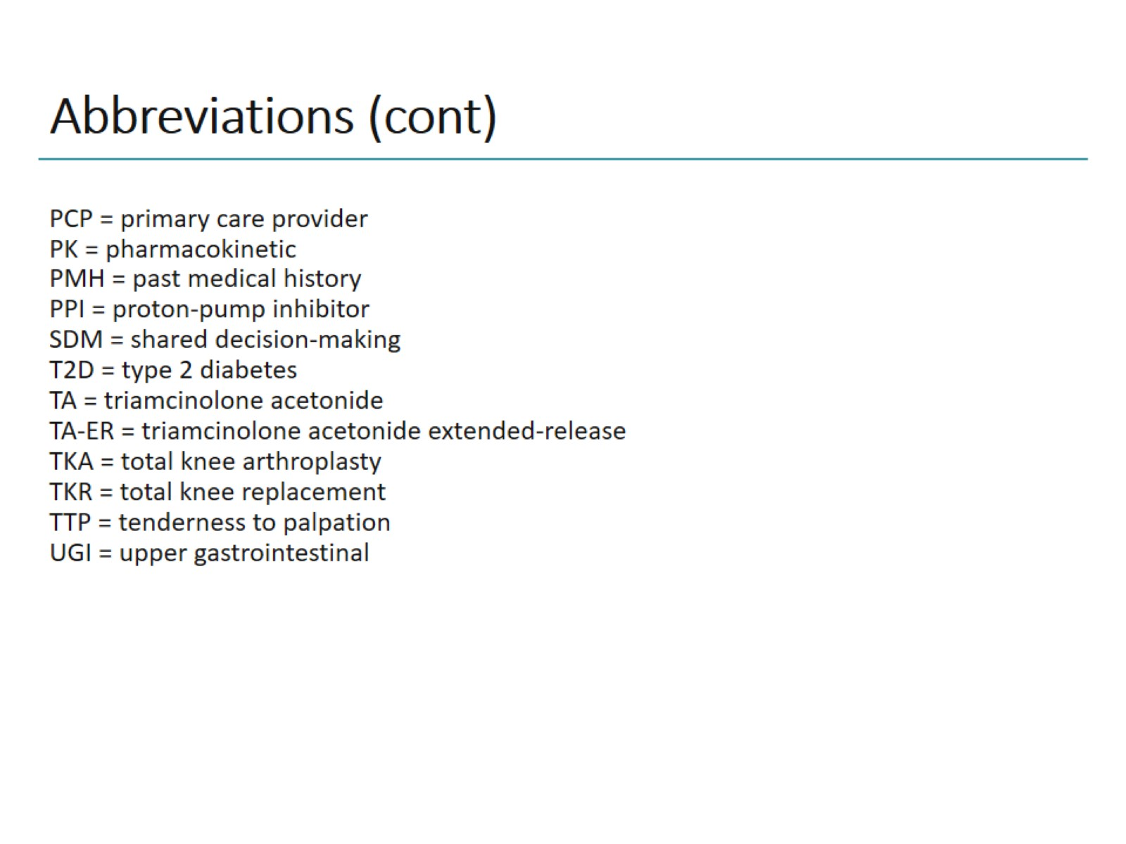
Abbreviations (cont)

